Slide 1
Introduction fMRI based on FUNCTIONAL Magnetic Resonance Imaging by Huettel et al.

Slide 2
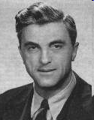
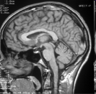
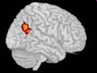
MRI
1971 Raymond Damadian proved that magnetic resonance could be used to help detect diseases by the different nuclear magnetic relaxation times between tissues and tumors.
1973 Paul Lauterbur demonstrated magnetic resonance imaging on test tubes.
1977 Raymond Damadian completed the first whole body MRI scanner which he called "Indomitable."
1977 Raymond Damadien performed the first whole body scan using Indomitable. It lasted four hours and 45 minutes to complete.
1992 functional MRI was developed (Ogawa and Kwong)

Slide 3
Overview
fMRI Scanner
- static magnetic field, gradient coils, safety etc.
MR Signal generation
- magnetic moment, relaxation
MR Image formation
- slice selection, frequency and phase encoding
MR Contrast
T1, T2 and T2*
BOLD-signal
- neurovascular coupling, characterisation of the signal

Slide 4
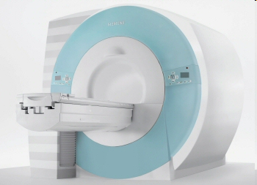
fMRI scanner
Static magnetic field (0.5-14 T)
Radiofrequency coils
Gradient coils
Shimming coils
Computer hardware and software
Siemens, 3T Trio

Slide 5
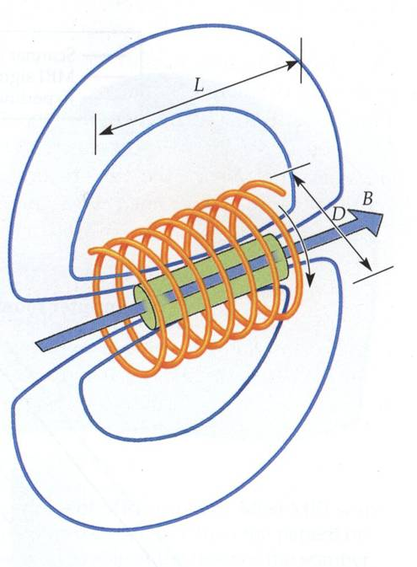
Static magnetic field
Generated by Helmholtz Coils
- Currents are parallel (same direction)
- Field along MRI axis
Superconducting electromagnets
-(0.5-11 Tesla, -261°C)
field uniformity
- Homogentiy in space and time

Slide 6
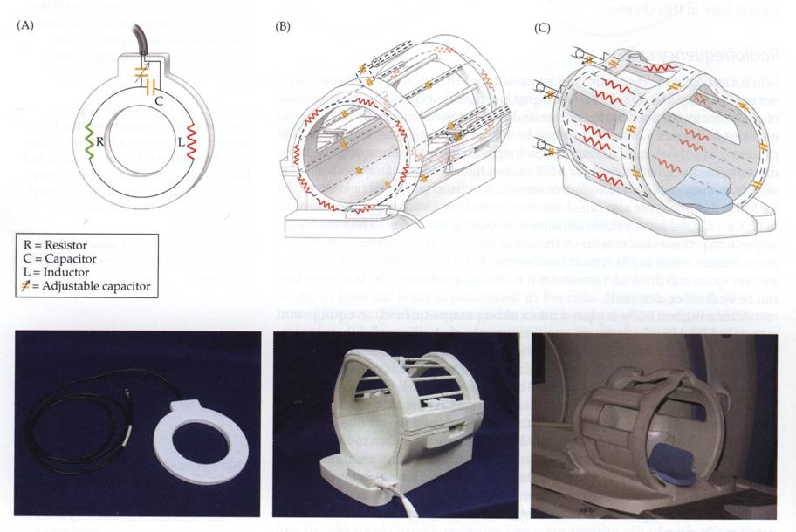
Radiofrequency coils
Defined by function:
- Transmit/receive coil
- Transmit only coil
- Receive only coil
Defined by geometry
- Surface coil (High sensitivity but limited coverage)
- Volume coil (low sensitivity but uniform coverage)
- Phased-array coil (High sensitivity, near-uniform coverage)

Slide 7
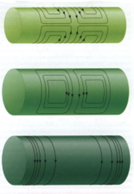
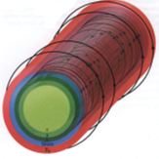
Gradient and shimming coils
solenoid
solenoid
A number of different electromagnetic coils are used to generate the
B0-field and the gradients in x-, y-, and z-direction. Shimming coils
generate compensatory magnetic fields correcting for inhomogenitie
in the B0 field.

Slide 8
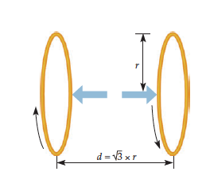
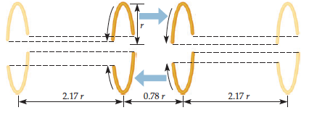
Gradient coils
A Maxwell pair, two loops with opposing currents, which generate magnetic field gradients along Z direction, i.e., the main magnetic field.
Golay pair which allows generation of magnetic field gradients in the X and Y direction, i.e., perpendicular to the main magnetic field.

Slide 9
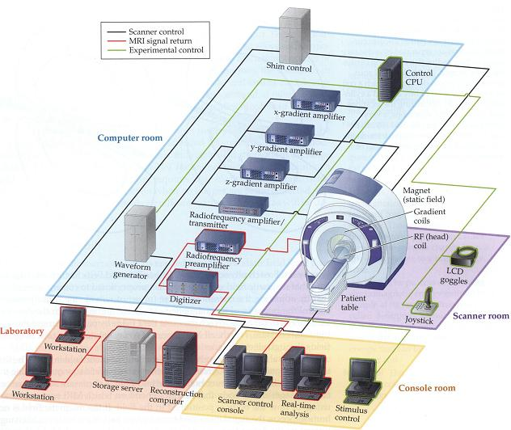
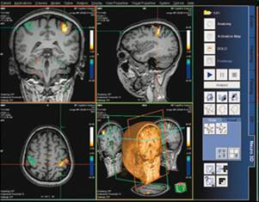
Computer hardware and software

Slide 10
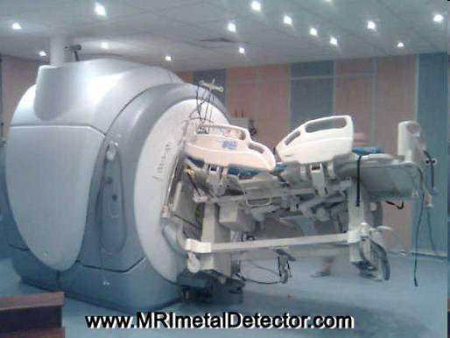
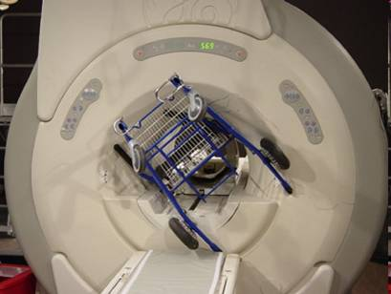
MR Safety
The magnet is never switched off!
Subjects are excluded having metal implant, pacemaker, aneurysm clip, tattoos,
foreign metal objects, neurostimulator etc. or being pregnant.

Slide 11
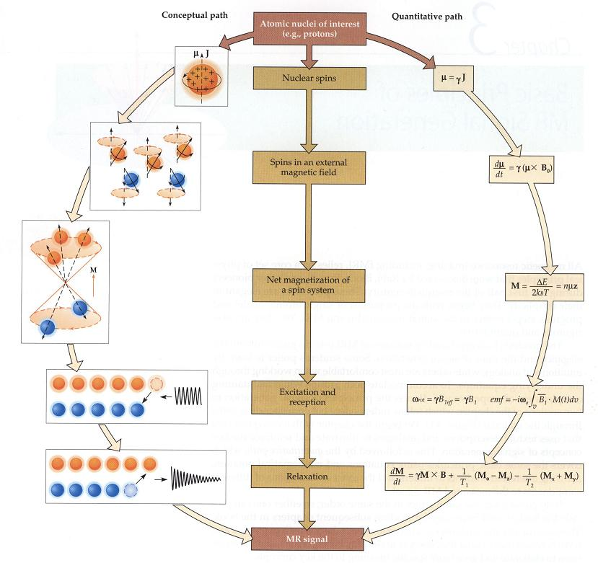
MR Signal generation

Slide 12
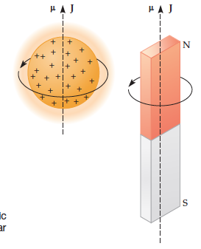
Nuclear Spin
A spinning proton and a spinning bar magnet have angular momentums (J) and magnetic moments (μ). The angular momentums are generated by the spinning masses; the magnetic moment for the spinning proton is due to the electric current, which is induced by the rotating charge. The magnetic moment for the bar magnet comes from the movement of its internal magnetic field

Slide 13
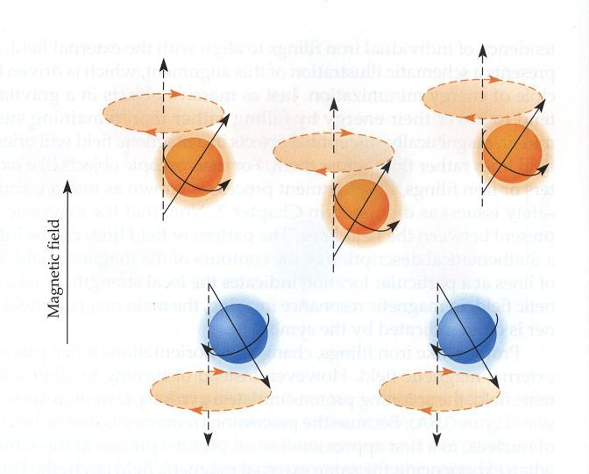
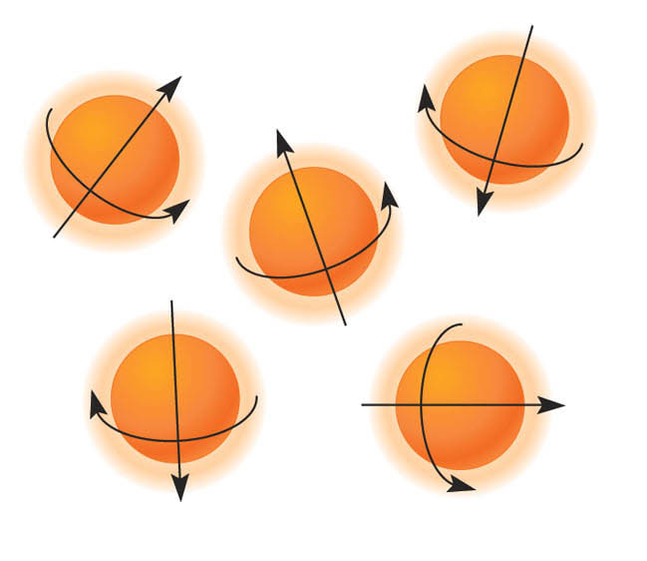
Magnetic moment
In the absence of a strong
magnetic field:
the spins are oriented randomly
In a magnetic field:
protons can take either
high- or low-energy states

Slide 14
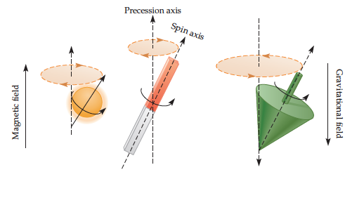
Precession
The movement of a rotating proton or magnet within a magnetic field is similar to the movement of a top in Earth’s gravitational field, i.e., . the axis of spin itself (spin axis) wobbles around the main axis of the magnetic or gravitational field (precession axis).

Slide 15
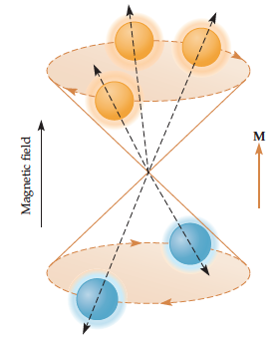
Net Magnetization
Small B0 produces small net magnetization
Thermal motions try to randomize alignment of proton magnets
Larger B0 produces larger net magnetization, lined up with B0
At room temperature, the population ratio is roughly 100,000 to
100,006 per Tesla of B0

Slide 16
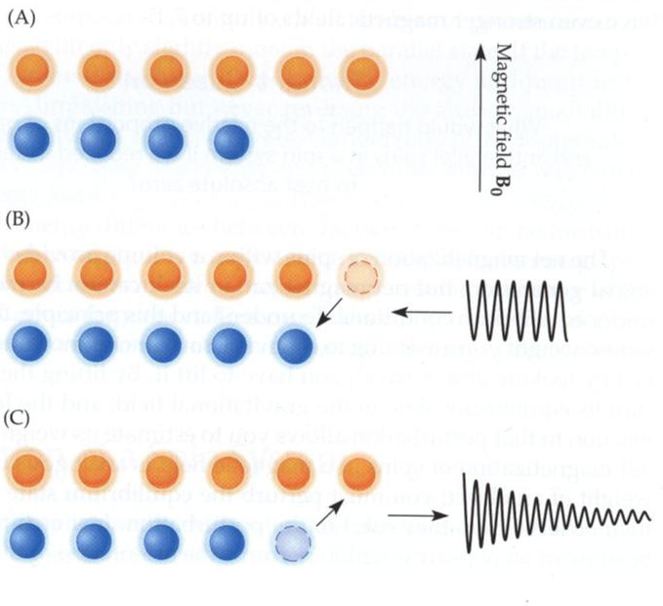
Excitation of a Spin System
More spins in an external magnetic field will be at a low-energy level
Excitation pulse is applied and some spines will jump to the high-energy state
High-energy spins will return to the low energy state (relaxation)

Slide 17
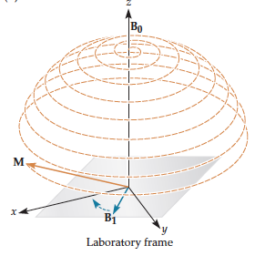
Excitation of a Spin System
The delivery of an excitation pulse (B1) causes the longitudinal magnetization (M) to be tipped into the transverse plane. The longitudinal net magnetization would trace out a complex wobbling path as it rotates downward to the transverse plane

Slide 18
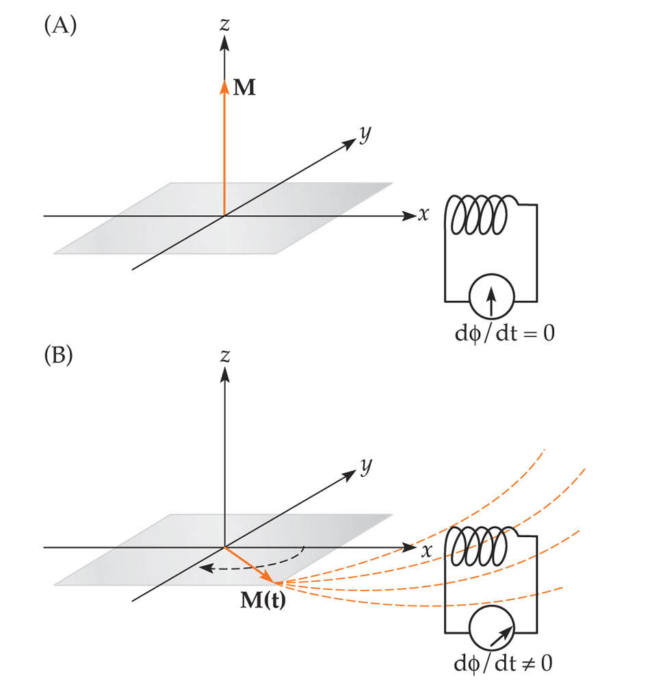
Signal Reception
Before Excitation
After Excitation
Excitation tips the net magnetization down into the transverse plane,
where it can generate current in detector coils (i.e., via induction).

Slide 19
Relaxation
In absence of external B1, the net magnetization will go back being
aligned with static field B0 — this is called relaxation
Part of net magnetization perpendicular to B0 shrinks; this part of
is called transverse magnetization (T2) and provides the detectable
RF signal
Part of net magnetization parallel to B0 grows back; it is called
longitudinal magnetization (T1) which is not directly detectable

Slide 20
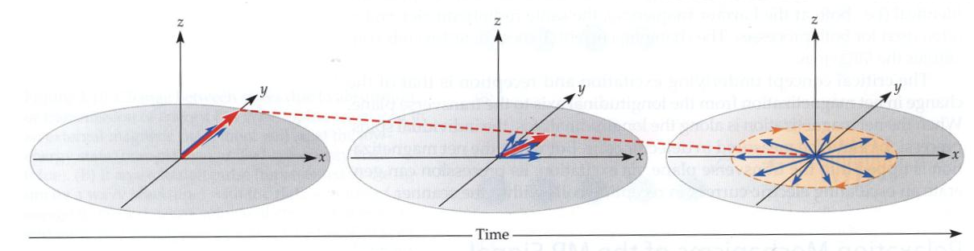
T2-Relaxation
T2: Intrinsic decay of the transverse magnetization
- Usually 50-100 ms in the brain [shortens with bigger B0]
T2*: Overall decay of the observable RF signal
- Usually about half of T2 in the brain [i.e., faster relaxation]

Slide 21
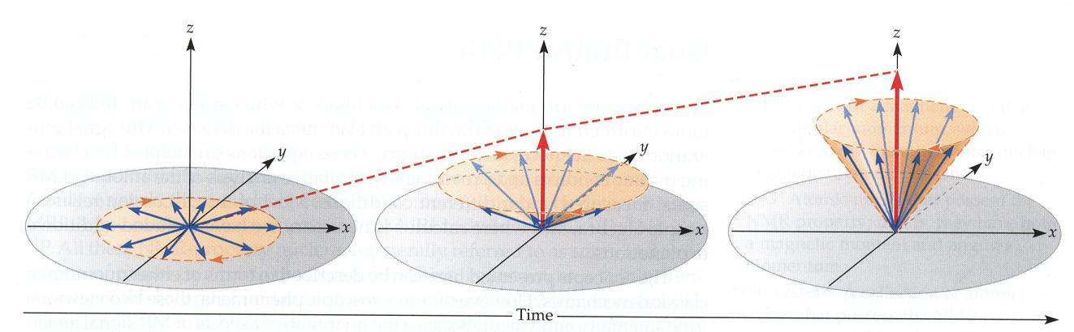
T1-Relaxation
T1: Relaxation of net magnetization back to alignment with B0
- Usually 500-1000 ms in the brain [lengthens with bigger B0]

Slide 22
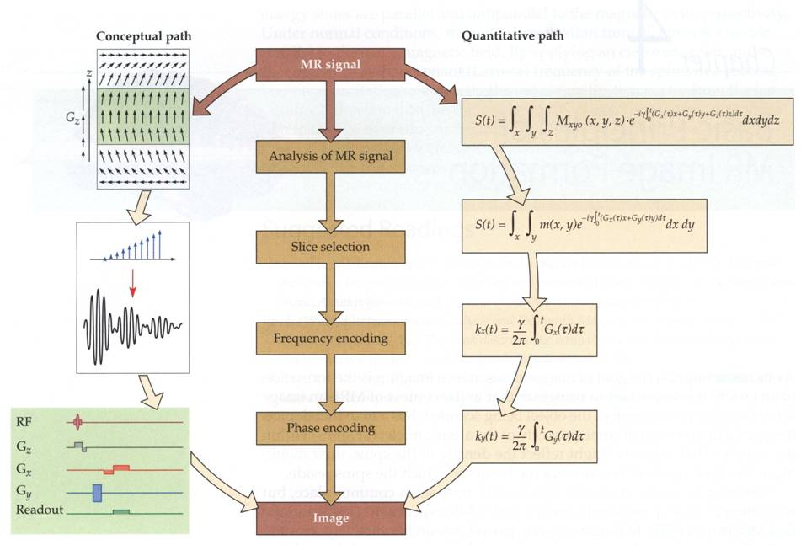
MR Image formation

Slide 23
Magnetic gradients
z
z
z
y
y
y
x
x
x
X gradient Y gradient Z gradient
Gradient coils generate varying magnetic field so that spins at different
location precess at frequencies unique to their location, allowing us to
reconstruct 2D or 3D images.

Slide 24
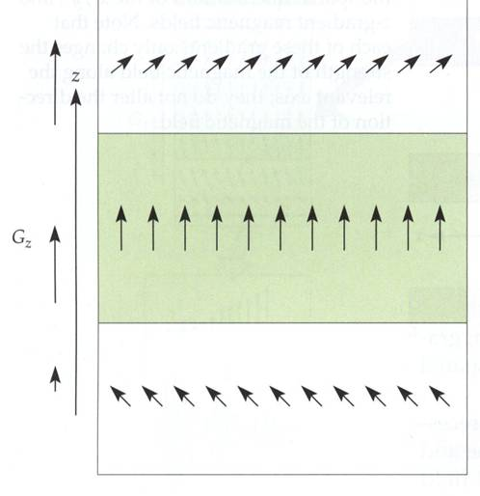
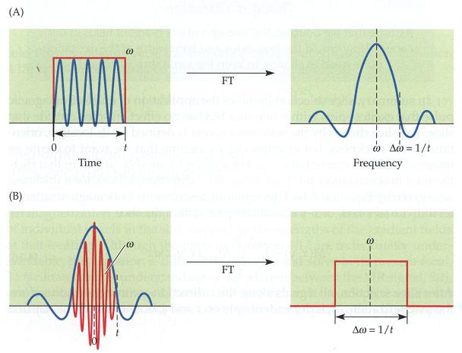
Slice selection
Excite and receive net magnetization in a thin (2D) slice of the subject
- RF signal must come from this slice
- Reduce dimension from 3D down to 2D

Slide 25
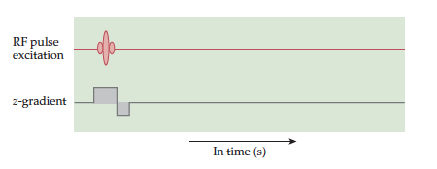
Pulse sequence for slice selection
To select a slice, an excitation pulse is delivered through the radiofrequency coil (RF; a head coil in fMRI) with a magnetic gradient. Each line of a pulse sequence diagram indicates a separate component of the scanner hardware (x-axis indicating time, y-axis indicating the strength of that
Component).

Slide 26
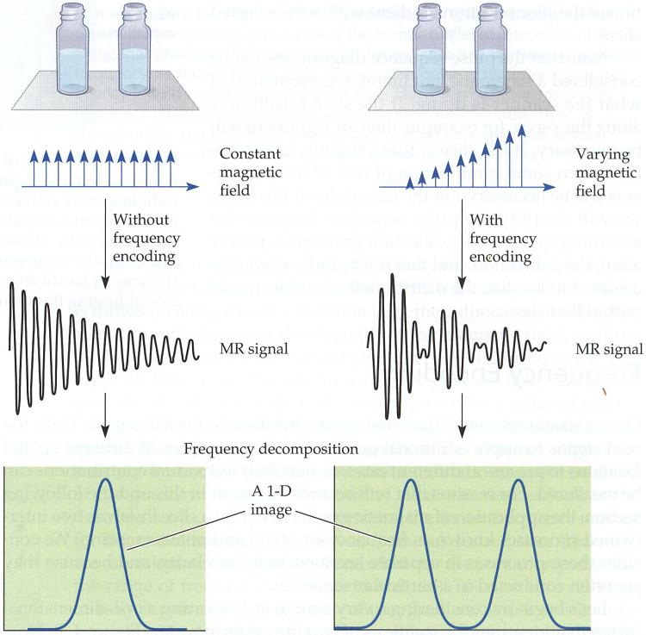
Frequency encoding
Deliberately make magnetic field strength B depend on location within slice
- Frequency of RF signal will depend on where it comes from
- Breaking signal into frequency components will provide localization information

Slide 27
Frequency and phase encoding
During readout (image acquisition) period, turning on gradient field is called
frequency encoding --- using a deliberately applied nonuniform field to make
the precession frequency depend on location.
Before readout (image acquisition) period, turning on gradient field is called
phase encoding --- during the readout (image acquisition) period, the effect
of gradient field is no longer time-varying, rather it is a fixed phase accumulation
determined by the amplitude and duration of the phase encoding gradient.

Slide 28
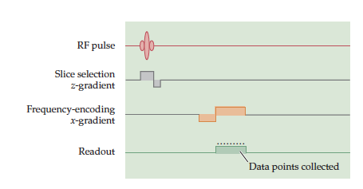
Pulse sequence with frequency encoding
To create a one-dimensional map within a slice, a second magnetic gradient must be applied during data acquisition. Note that data acquisition usually occurs with some delay after excitation for T1- or T2-sensitive images.

Slide 29
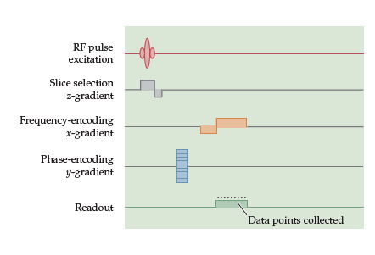
Pulse sequence with frequency and phase encoding
To create a two-dimensional image of a given slice, two independent magnetic gradients must be used within that slice, i.e., a phase encoding gradient is applied before the frequency-encoding gradient, so that there is time for phase differences among spins to accumulate along that direction.

Slide 30
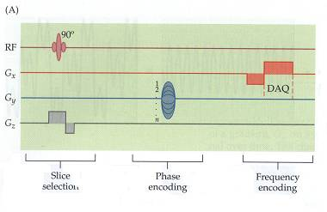
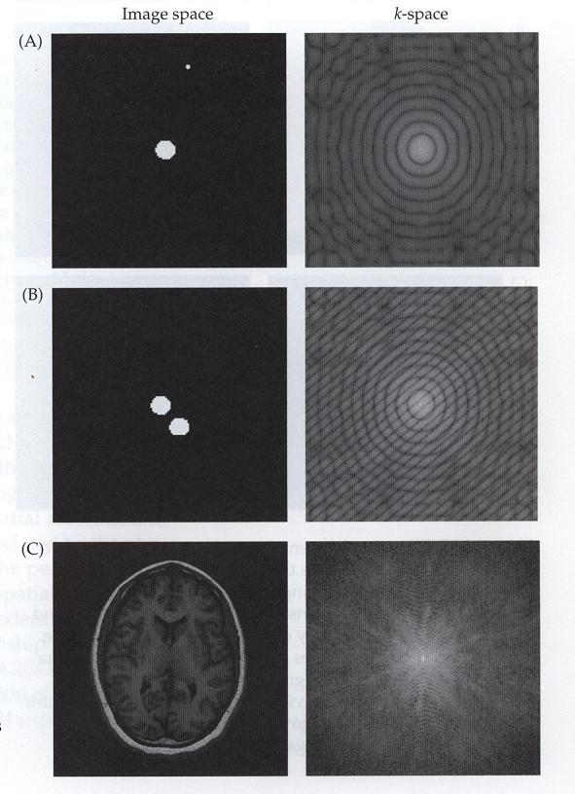
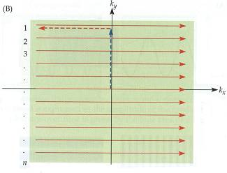
k-space

Slide 31
MR Contrast
Contrast = difference in RF signals (emitted by water protons)
between different tissues

Slide 32
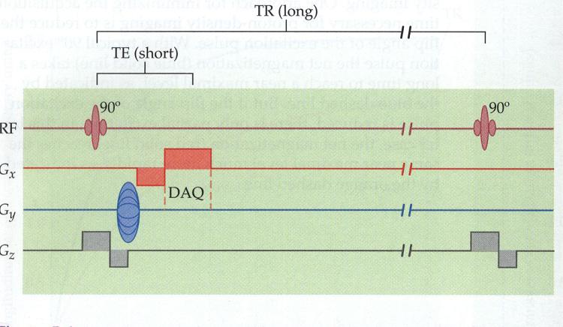
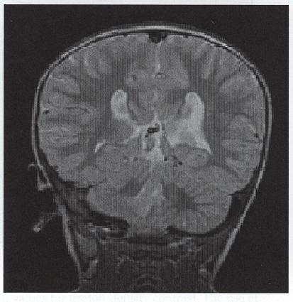
Proton-density
Technique: use very long time between RF (large TR) and very short
delay between excitation and readout window (short TE)
- useful for anatomical reference scans
~ 1 mm resolution

Slide 33
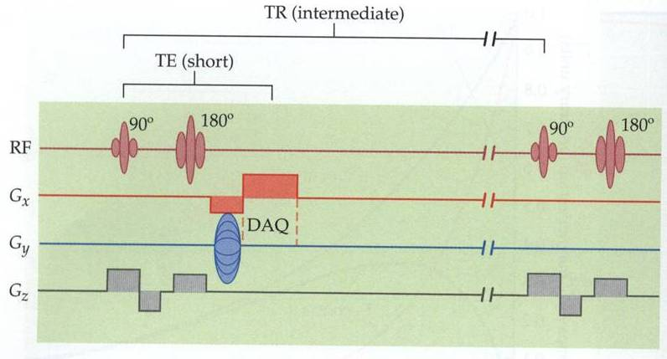
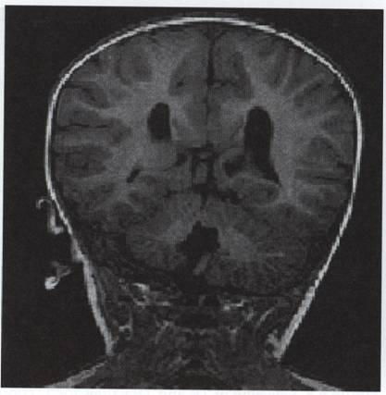
T1
Technique: use intermediate timing between RF (intermediate TR) and
very short TE
- useful for anatomical reference scans
~1 mm resolution

Slide 34
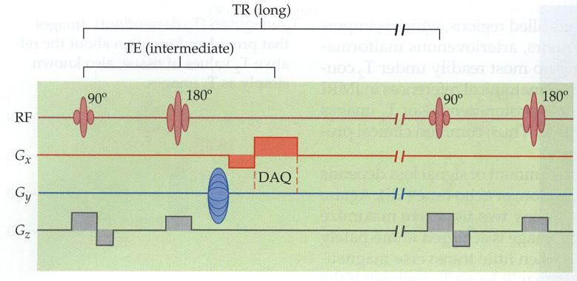
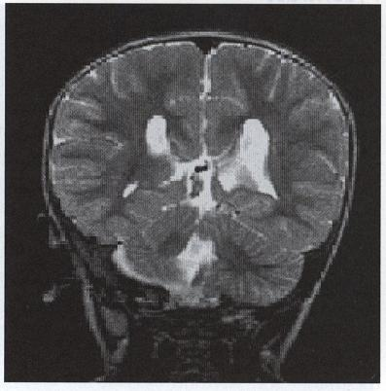
T2
Technique: use large TR and intermediate TE
- useful for anatomical and functional studies
- 1mm resolution for anatomical scans or 3 mm functional scans

Slide 35
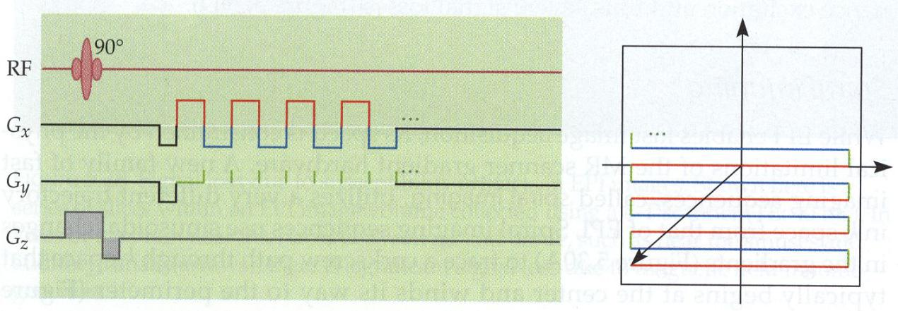
EPI and T2*
Methods shown earlier take multiple RF shots to readout enough
data to reconstruct a single image
Each RF shot gets data with one value of phase encoding
If gradient system (power supplies and gradient coil) are good
enough, can read out all data required for one image after one
RF shot (signal is available in 2*T2* [80 ms])

Slide 36
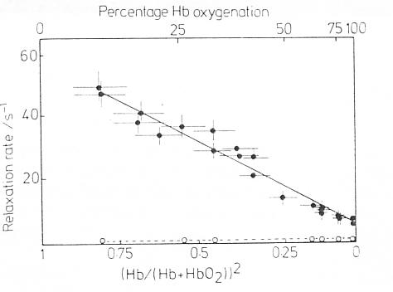
BOLD-signal affects T2
T2
Decreasing Relaxation Time
T1
Increasing Blood Oxygenation
Thulborn et al., 1982

Slide 37
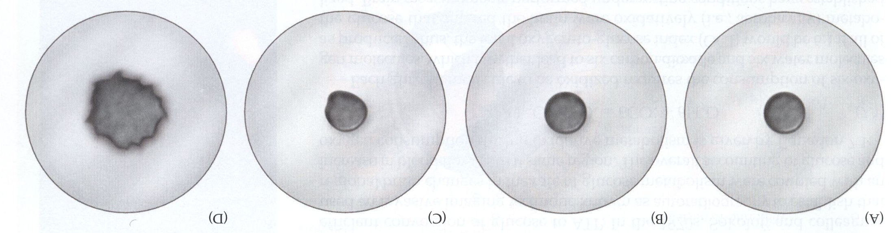
BOLD-signal
Ogawa 1990
Oxygenated blood in tube leads to little signal change, either on
spin- or gradient-echo images
Deoxygenated blood leads to large susceptibility effects on gradient-
echo images

Slide 38
BOLD Endogenous Contrast
Blood Oxyenation Level Dependent Contrast
Deoxyhemoglobin is paramagnetic, oxyhemoglobin is less so.
Magnetic susceptibility of blood decreases linearly with increasing oxygenation
Oxygen is extracted during passage through capillary bed
Arteries are fully oxygenated
Venous (and capillary) blood has increased proportion of deoxyhemoglobin
Difference between oxy and deoxy states is greater for veins → BOLD sensitive to venous changes

Slide 39
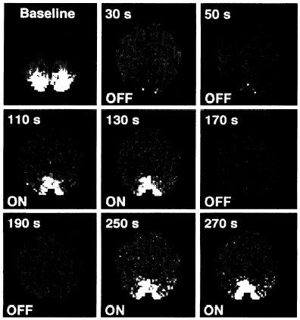
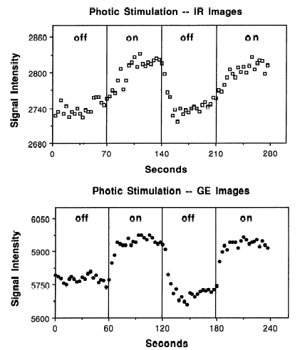
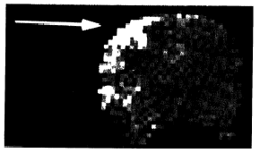
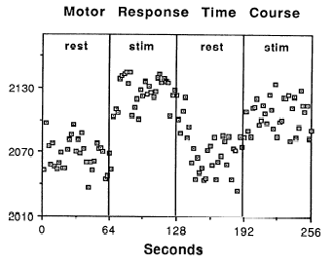
BOLD-signal
← VISUAL →
← MOTOR →
Kwong 1992

Slide 40
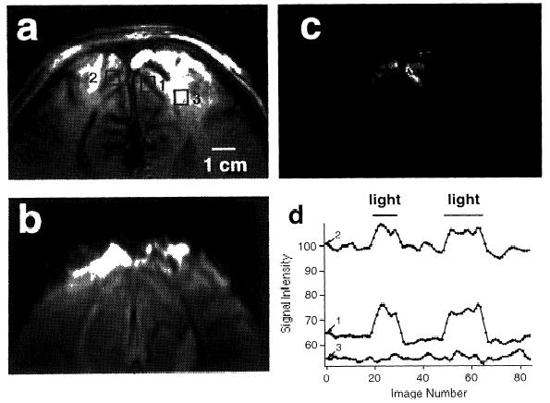
BOLD-signal
High-field (4T) in humans
Patterned visual stimulation at 10 Hz
Gradient-echo (GRE) pulse sequence used
Surface coil recorded
Ogawa 1992

Slide 41
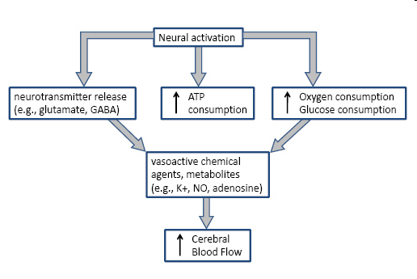

Neurovascular coupling
Neurovascular coupling refers to the relationship between local neural activity
and subsequent changes in cerebral blood flow (CBF)

Slide 42

Mechanism of BOLD Functional MRI
Brain activity
Oxygen consumption
Cerebral blood flow
Oxyhemoglobin
Deoxyhemoglobin
Magnetic susceptibility
T2*
MRI signal intesity

Slide 43



BOLD-signal and neuronal activity
BOLD response reflects pooled
local field potential activity
(Logothetis et al, 2001)

Slide 44

Time resolution BOLD-signal
Delay in the HDR: Hemodynamic activity lags neuronal
activity by 4-6 sec

Slide 45

Non-linearity BOLD-signal

Slide 46

Variability of the BOLD-signal
Across Subjects
Across Sessions
Across Brain Regions
Across Stimuli

Slide 47
Introduction SPM

Slide 48





SPM
Open Source academic freeware (under GPL)
Documented and informally supported
Requirements:
MATLAB: 7.1 (R14SP3) to 7.9 (R2009b) no toolboxes (EEG/MEG requires ‘signal’)
Supported platforms (MEX files):
File Formats:
Images: NIfTI-1 (& Analyze, DICOM)
Surface meshes: GIfTI
M/EEG: most manufacturers (with FieldTrip’s fileio)
Linux (32 and 64 bit)
Windows (32 and 64 bit)
Mac Intel (32 and 64 bit)

Slide 49




SPM Interface

Slide 50


Terminology of fMRI
Structural (T1) images:
- high resolution
- to distinguish different types of tissue
Functional (T2*) images:
- lower spatial resolution
to relate changes in BOLD signal
to an experimental manipulation
→ Time series:
A large number of images that
are acquired in temporal
order at a specific rate
t

Slide 51



Overview
Image time-series
Spatial filter
Design matrix
Statistical Parametric Map
Realignment
Smoothing
General Linear Model
Statistical Inference
RFT
Normalisation
Anatomical reference
p <0.05
Parameter estimates

Slide 52
Pre-Processing
Image time-series
Spatial filter
Design matrix
Statistical Parametric Map
Realignment
Smoothing
General Linear Model
Statistical Inference
RFT
Normalisation
Anatomical reference
p <0.05
Parameter estimates

Slide 53
Realignment
Even small head movements can be a major problem:
Movement artefacts add up to the residual variance and reduce sensitivity.
Data may get completely lost if sudden movements occur during a single volume
Movements may be correlated with the task performed
-> Minimising movements is one of the most important factors for ensuring
good data quality

Slide 54
Realignment
Each volume in the time-series is realigned
Using rigid-body registration
Assumes that brain shape doesn’t change
Least squares cost function
Realigned images must be resliced for analysis
Not necessary if they will be normalised anyway

Slide 55
Realignment
A 3D rigid body transform is defined by:
3 translations - in X, Y & Z directions
3 rotations - about X, Y & Z axes
The order of the operations matters
Pitch
about x axis
Roll
about y axis
Yaw
about z axis
Translations

Slide 56


Realignment
Minimising mean-squared difference works for intra-modal
registration (realignment)
Simple relationship between intensities in one image, versus
those in the other
Assumes normally distributed differences

Slide 57

Realignment

Slide 58

Slice-time-correction
Re-sampling can introduce interpolation errors especially
tri-linear interpolation
Slices are not acquired simultaneously rapid movements not
accounted for by rigid body model
Image artefacts may not move according to a rigid body model
image distortion
image dropout
Nyquist ghost
Functions of the estimated motion parameters can be modelled
as confounds in subsequent analyses

Slide 59
Normalization
Inter-subject averaging
Increase sensitivity with more subjects
Fixed-effects analysis
Extrapolate findings to the population as a whole
Mixed-effects analysis
Make results from different studies comparable by aligning them to
standard space e.g. using the MNI template

Slide 60


Normalization
T1
305
The Talairach atlas is not
exactly accurate for inter-
preting coordinates from
SPM analyses
PD
T2
SS
“Canonical” images in MNI space

Slide 61


Normalization
Minimise mean squared difference from template image(s)
Affine registration
Non-linear registration

Slide 62

Normalization
The first part is a 12 parameter affine transform
3 translations
3 rotations
3 zooms
3 shears
Fits overall shape and size
Algorithm simultaneously minimises
Mean-squared difference between template and source image
Squared distance between parameters and their expected
values (regularisation)

Slide 63


Normalization
Deformations consist of a linear combination of
smooth basis functions
These are the lowest frequencies of a 3D
discrete cosine transform
Algorithm simultaneously minimises
Mean squared difference between
template and source image
Squared distance between parameters
and their known expectation

Slide 64
Smoothing
Why would we deliberately blur the data?
- Suppress noise and effects due to differences in
anatomy by averaging over neighbouring voxels
- Achieve better spatial overlap, enhanced sensitivity,
and greater validity of statistical assumptions
- Reduce the effective number of multiple
comparisons when correcting results using Random
Field Theory
How is it implemented?
Convolution with a 3D Gaussian kernel, of specified
Full-width at half-maximum (FWHM) in mm

Slide 65

Smoothing
Smoothing is done by convolution.
Each voxel after smoothing effectively becomes the result of
applying a weighted region of interest (ROI).
Before convolution
Convolved with a circle
Convolved with a Gaussian

Slide 66
Voxel-Based Morphometry
Many interesting and clinically important questions might relate
to the shape or local size of regions of the brain
For example, whether (and where) local patterns of brain
morphometry help to:
- Distinguish schizophrenics from healthy controls
- Understand plasticity, e.g. when learning new skills
- Explain the changes seen in development and aging

Slide 67



Alzheimer’s Disease example
_{Baseline Image}
_{Standard clinical MRI}
_{1.5T T1 SPGR}
_{1x1x1.5mm voxels}
_{Repeat image}
_{12 month follow-up} _{rigidly registered}
_{Subtraction image}

Slide 68
Alzheimer’s Disease example
Some changes are apparent in this patient...
Some might be noise or misregistration etc.
Perhaps confounding biological effects like hydration changes etc.
But some might genuinely reflect underlying AD pathology...
Would changes generalise from the patient to the disease?
It is appealing to try a “second-level” SPM analysis of structural data
variation over subjects
E.g. AD vs. healthy, male vs. female or a correlation with IQ

Slide 69

Pre-processing for VBM

Slide 70
Tissue segmentation
High-resolution MRI reveals fine structural detail in the brain, but not all of
it reliable or interesting
Noise, intensity-inhomogeneity, vasculature, …
MR Intensity is usually not quantitatively meaningful
fMRI time-series allow signal changes to be analysed statistically,
compared to baseline or global values
Regional volumes of the three main tissue types: gray matter, white
matter and CSF, are well-defined and potentially very interesting
Other aspects (and other sequences) can also be of interest

Slide 71



Tissue segmentation
Structural image, GM and WM segments, and brain-mask (sum of GM and WM)

Slide 72

Tissue segmentation
Intensities are modelled by a Gaussian Mixture Model (AKA Mixture Of Gaussians)
With a specified number of components
Parameterised by means, variances and mixing proportions (prior probabilities for components)

Slide 73

Tissue Probability
Tissue probability maps (TPMs) are used instead of the proportion of voxels in each Gaussian as the prior.
ICBM Tissue Probabilistic Atlases (kindly provided by the International Consortium
for Brain Mapping, John C. Mazziotta and Arthur W. Toga.

Slide 74

Aligning the tissue probability maps
Initially affine-registered using a multi-dimensional form of mutual information
Iteratively warped to improve the fit of the unified segmentation model to the data
Familiar DCT-basis function concept, as used in normalisation

Slide 75

Segmentation

Slide 76


DARTEL
Template 1
Rigid average
Template 6

Slide 77
Modulation
1 1
Multiplication of the warped (normalised) tissue intensities so that their regional or global volume is preserved
Can detect differences in completely registered areas
Otherwise, we preserve concentrations, and are detecting mesoscopic effects that remain after approximate registration has removed the macroscopic effects
Flexible (not necessarily “perfect”) registration may not leave any such differences
Native
1 1 1 1
Unmodulated
2/3 1/3 1/3 2/3
Modulated

Slide 78
Total Intracranial Volume (TIV/ICV)
“Global” integrated tissue volume may be correlated with
interesting regional effects
Correcting for globals in this case may overly reduce sensitivity
to local differences
Total intracranial volume integrates GM, WM and CSF, or
attempts to measure the skull-volume directly
Not sensitive to global reduction of GM+WM (cancelled out by
CSF expansion – skull is fixed!)
Correcting for TIV in VBM statistics may give more powerful
and/or more interpretable results

Slide 79





Statistical Parametric Mapping…
–
parameter estimate
group 1
group 2
CBF
x
k
r
x
1
ζ
x
x
o
=
α
k
2
o
voxel by voxel modelling
x
α
x
o
o
k
1
o
o
g..
gCBF

Slide 80

VBM in pictures
Segment
Normalise

Slide 81


VBM in pictures
Modulate

Slide 82



VBM in pictures
Voxel-wise statistics

